Slide 1
Amazon Rating Analysis
File created on: 8/19/2025 11:50:44 AM

Slide 2
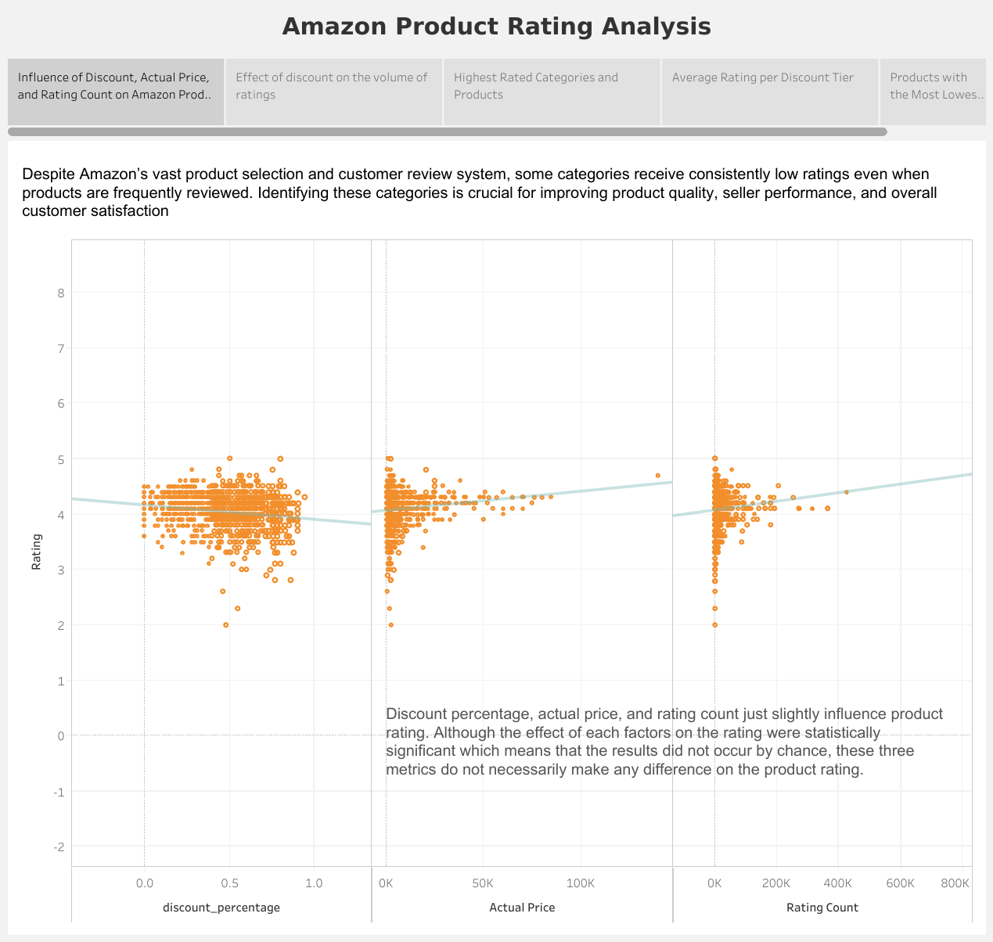

Slide 3
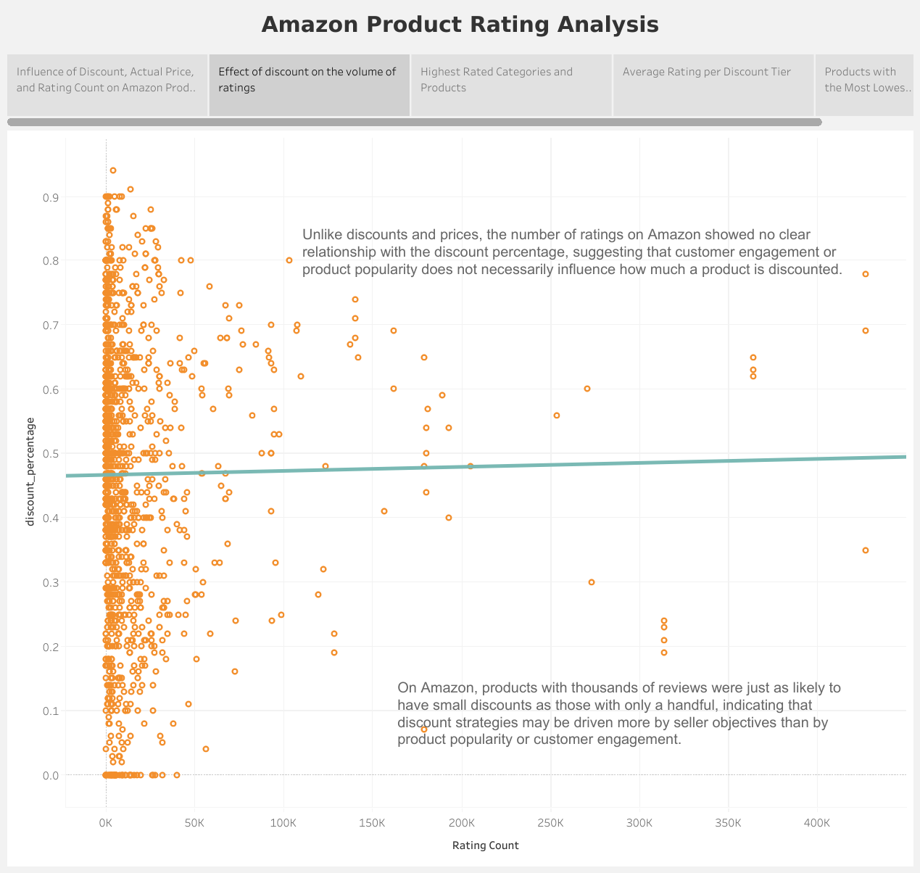

Slide 4
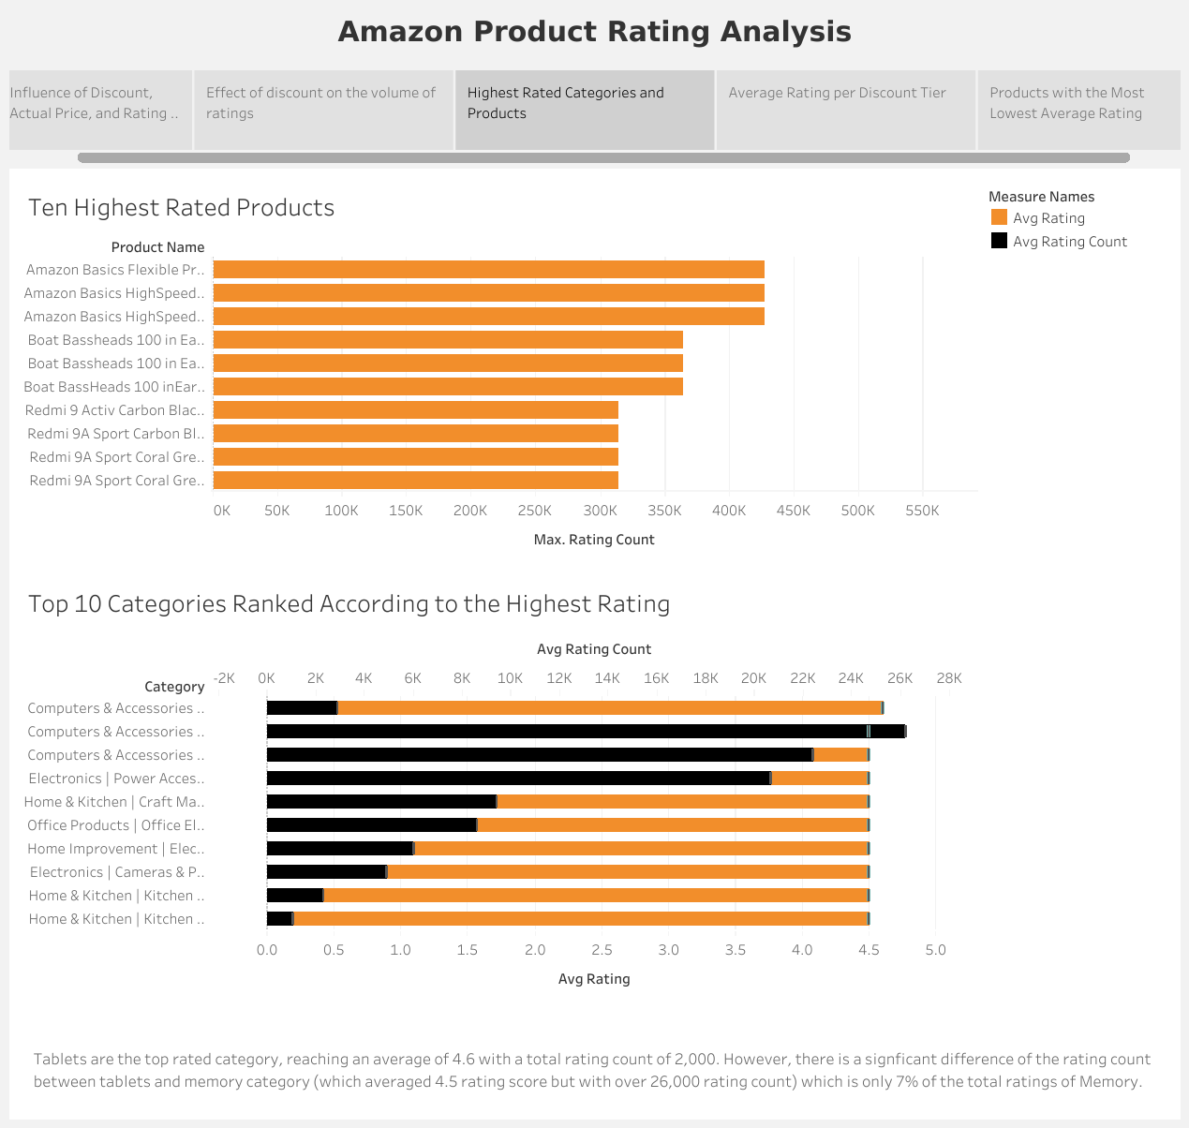

Slide 5
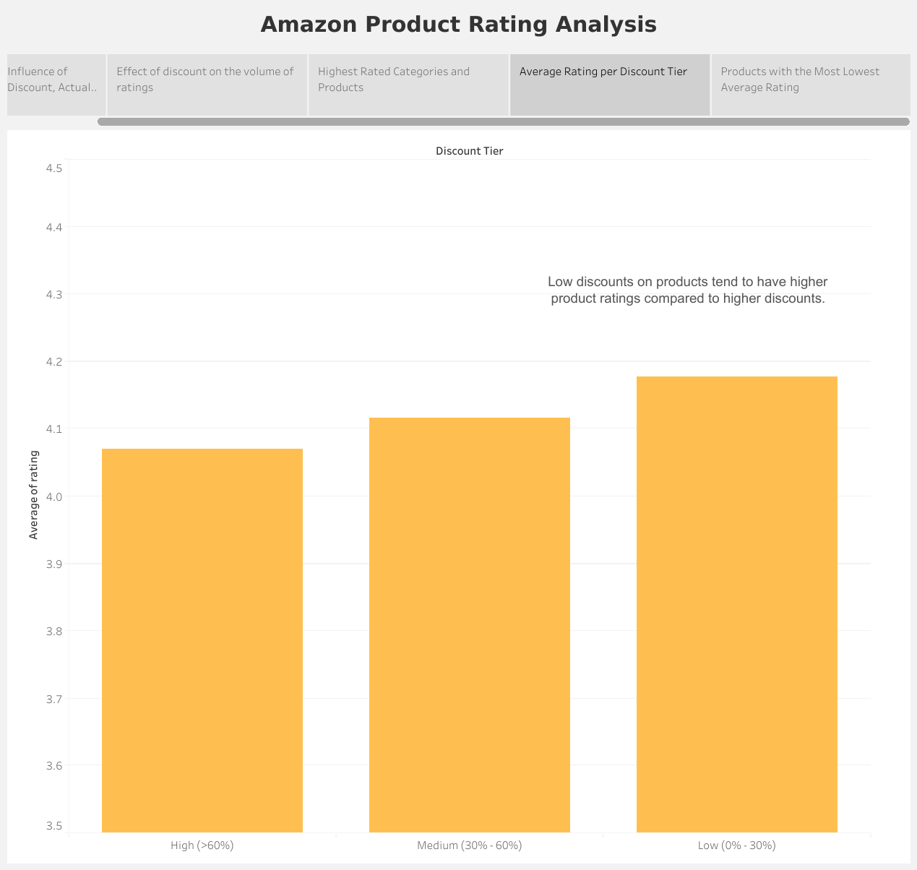

Slide 6
